Slide 1
Practice Of Health Education
Dr M.V .Ajithkumar M.D (Hom)
Professor & Head Dept of Community Medicine
SKHMC

Slide 2
Practice Of Health Education
1. Audio – visual aid : .
No health education can be effective without audiovisual
aids.
They help to simplify unfamiliar concepts; bring about
understanding where words fail; reinforce learning by
appealing to more than one sense, and provide a dynamic
way of avoiding monotony.

Slide 3
Audiovisual aids
classified into three groups.
a.. Auditory aids
b. Visual aids
c. Combined A-V aids

Slide 4
Auditory Aid- Health education can be done through hearing. eg: radio, tape recorder etc..
Visual Aids- Health education is given by seeing the matter.
It is of 2 types-
1. Not requiring projections- eg: leaflets, charts, posters etc..
2. Requiring projections-
eg: slides, film strips etc..

Slide 5
c. Combined A-V Aid-
Both auditory and visual means are using for health education.
eg: television, sound films etc

Slide 6
Methods in health education
It is the way through which the educator is communicate with the audience. Broadly it is classified into:
1.Individual approach
2. Group approach
3.Mass approach

Slide 7
1 . Individual approach
There are plenty of opportunities for individual health education. It may be given in personal interviews in the consultation room of the doctor or in the health centre or in the homes of the people.
The individual comes to the doctor or health centre because of illness.
The responsibility of the attending physician in this regard, is very great because he has the confidence of the patient.
The patient will listen more readily to the physician's health counselling.

Slide 8
The biggest advantage of individual health teaching is that we can discuss, argue and persuade the individual to change his behaviour.
The limitation of individual health teaching is that the numbers we reach are small, and health education is given only to those who come in contact with us.

Slide 9
2. Group approach
Group teaching is an effective way of educating the community.
We have to select the suitable method of health education including audio-visual aids for successful group health education.

Slide 10
TYPES
a. Chalk and talk (Lecture )
A lecture is defined as carefully prepared oral presentation of facts by a qualified person.
Its effectiveness depends to a large extent on the speaker's ability to write legibly and to draw with chalk on a black board.
The talk should be based on a topic of current interest or health needs of the group.
The group should not be more than 30 and the talk should not exceed 15 to 20 minutes.
If the talk is too long people may become bored and restless.

Slide 11
Lectures can be faulted on a number of grounds.
Their disadvantages include the following : students are involved to a minimum extent; learning is passive; do not stimulate thinking or problem-solving capacity; the comprehension of a lecture varies with the student; and the health behaviour of the listeners is not necessarily affected.

Slide 12
b. Demonstrations
A demonstration is a carefully prepared presentation to show how to perform a skill or procedure. Here a procedure (e.g. lumber puncture, disinfection of a well) is carried out step by step before an audience or the target group, the demonstrator ascertaining that the audience understands how to perform it. The demonstrator involves the audience in discussion.

Slide 13
Demonstration as a means of communication has been found to have a high educational value in programes like
environmental sanitation (e.g., installation of a hand-pump, construction of a sanitary latrine);
mother and child health (e.g. demonstration of oral rehydration technique)
control of diseases (e.g., scabies).
The clinical teaching in hospitals is based on demonstrations. This method has a high motivational value.

Slide 14
c. Group discussion
A "group" is an "aggregation of people interacting in a face-to-face situation". It permits the individuals to learn by freely exchanging their knowledge, ideas and opinions. Group discussion provides a wider interaction among members than is possible with other methods.

Slide 15
For effective group discussion, the group should comprise not less than 6 and not more than 12 members. The participants are all seated in a circle, so that each is fully visible to all the others . There should be a group leader who initiates the subject, helps the discussion in the proper manner, prevents side-conversations, encourages everyone to participate and sums up the discussion in the end. If the discussion goes well, the group may arrive at decisions which no individual member would have been able to make alone.

Slide 16
The "recorder" prepares a report on the issues discussed and agreements reached. In a group discussion, the members should observe the following rules :
express ideas clearly and concisely
listen to what others say.
do not interrupt when others are speaking
make only relevant remarks
accept criticism gracefully and
help to reach conclusions .

Slide 17
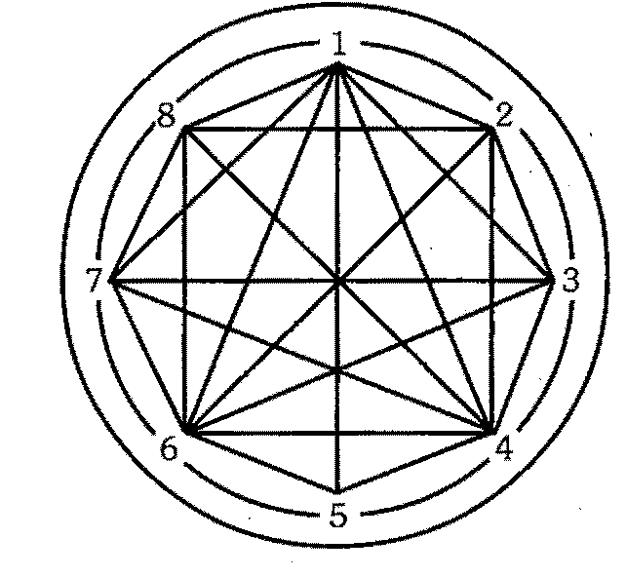

Slide 18
Limitations :
Group discussion is not without limitations. Those who are shy may not take part in the discussions. Some may dominate the discussion . Thus there may be unequal participation of members in a group discussion, unless properly guided. Some members may deviate from the subject and make the discussion irrelevant.

Slide 19
d. Panel discussion
In a panel discussion, 4 to 8 persons who are qualified to talk about the topic sit and discuss a given problem, or the topic, in front of a large group or audience. The panel comprises, a chairman or moderator and from 4 to 8 speakers. The chairman opens the meeting, welcomes the gatherings. He introduces the panel speakers.

Slide 20
The success of the panel depends upon the chairman; he has to keep the discussion going and develop the train of thought. After the main aspects of the subject are explored by the panel speakers, the audience is invited to take part. The discussion should be spontaneous and natural. If members of the panel are unacquainted with this method, they may have a preliminary meeting, prepare the material on the subject and decide upon the method and plan of presentation. Panel discussion can be an extremely effective method of education.

Slide 21
e. Symposium
A symposium is a series of speeches on a selected subject. Each person or expert presents an aspect of the subject briefly. There is no discussion among the symposium members like in panel discussion. In the end, the audience may raise questions. The chairman makes a comprehensive summary at the end of the entire session.

Slide 22
Workshop –
The workshop is the name given to a novel experiment in education. It consists of a series of meetings, usually four or more, with emphasis on individual work, within the group, with the help of consultants and resource personnel. The total workshop may be divided into small groups and each group will choose a chairman and a recorder. The individuals work, solve a part of the problem through their personal effort with the help of consultants, contribute to group work and group discussion and leave the workshop with a plan of action on the problem. Learning takes place in a friendly, happy and democratic atmosphere, under expert guidance. The workshop provides each participant opportunities to improve his effectiveness as a professional worker.

Slide 23
g. Role playing -
Role playing or socio-drama is based on the assumption that many values in a situation cannot be expressed in words, and the communication can be more effective if the situation is dramatised by the group. The group members who take part in the socio-drama enact their roles as they have observed or experienced them. The audience is not passive but actively concerned with the drama. They are supposed to pay sympathetic attention to what is going on, suggest alternative solutions at the request of the leader and if requested, come up and take an active part by demonstrating how they feel a particular role should be handled. The size of the group is thought to be best at about 25. Role playing is a useful technique to use in providing discussion of problems of human relationship. It is a particularly useful educational device for school children. Role playing is followed by a discussion of the problem.

Slide 24
Conferences and seminars-
This category contains a large component of commercialized continuing education. The programmes are usually held on a regional, state or national level. They range from once half-day to one week in length and may cover a single topic in depth or be broadly comprehensive. They usually use a variety of formats to aid the learning process from self instruction to multi-media.

Slide 25
3. Mass approach
Mass medias are used for health education. The evolution of the media has been rapid. Mass media are one way communication. They are useful in transmitting messages to people even in remotest places. Mass media alone is inadequate in changing human behaviour. Other approaches also needed for effective communication.

Slide 26
Different modes of mass media are given below :
1.Television
2.Radio
3.Internet
4.Newspapers
5.Printed material
6.Direct mailing
7.Health museums & exhibitions
8.Folkmedia

